Slide 1
SQL Data Tools
Mainly for Cube creation

Slide 2
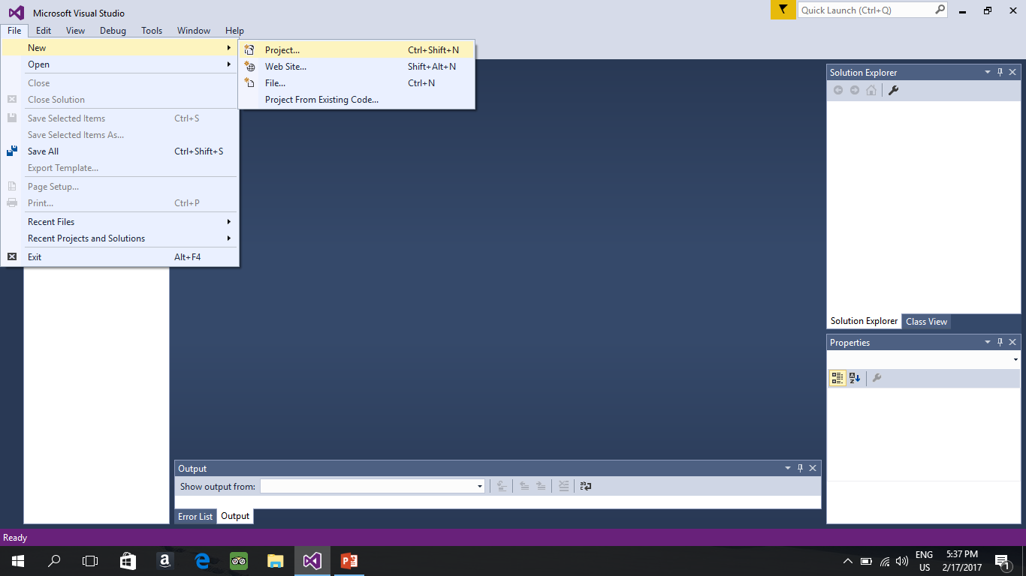
First Open new Project

Slide 3
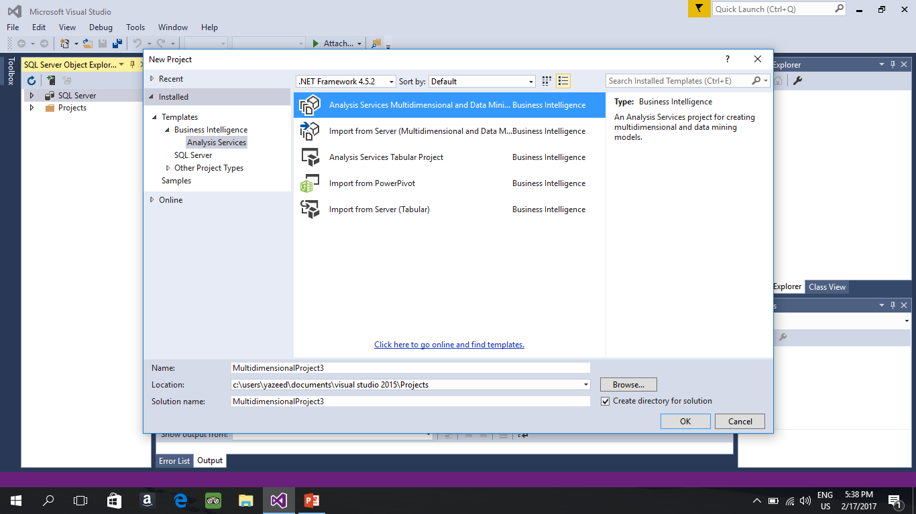
Type of Project choose multidimensional DM

Slide 4
Cube Creation
SQL Data tools is for cube creation , there are things you need to do first before Creating Cube.
1.Giving the data source(You already created it in SQL Management Studio)
2. Create a Data view
3. Create the Cube

Slide 5
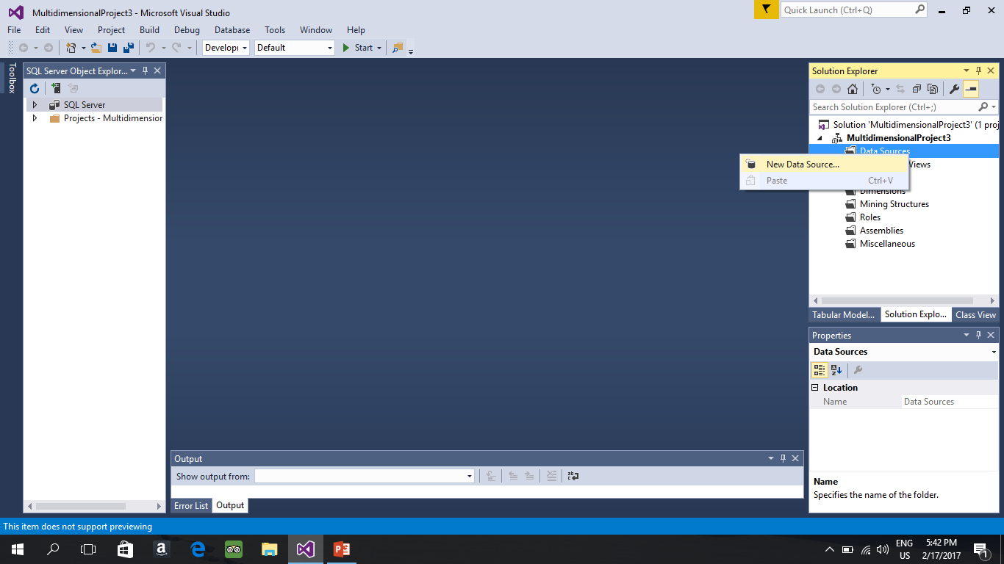
Giving the Data source

Slide 6
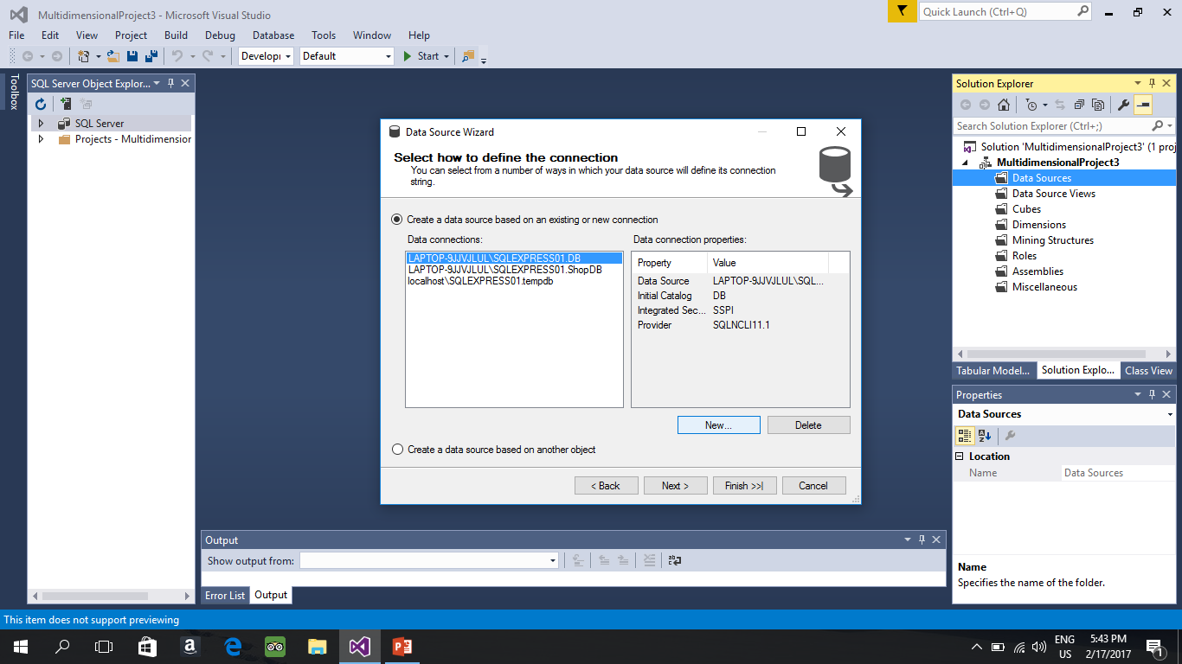
Cont click on new (the list might be empty)

Slide 7
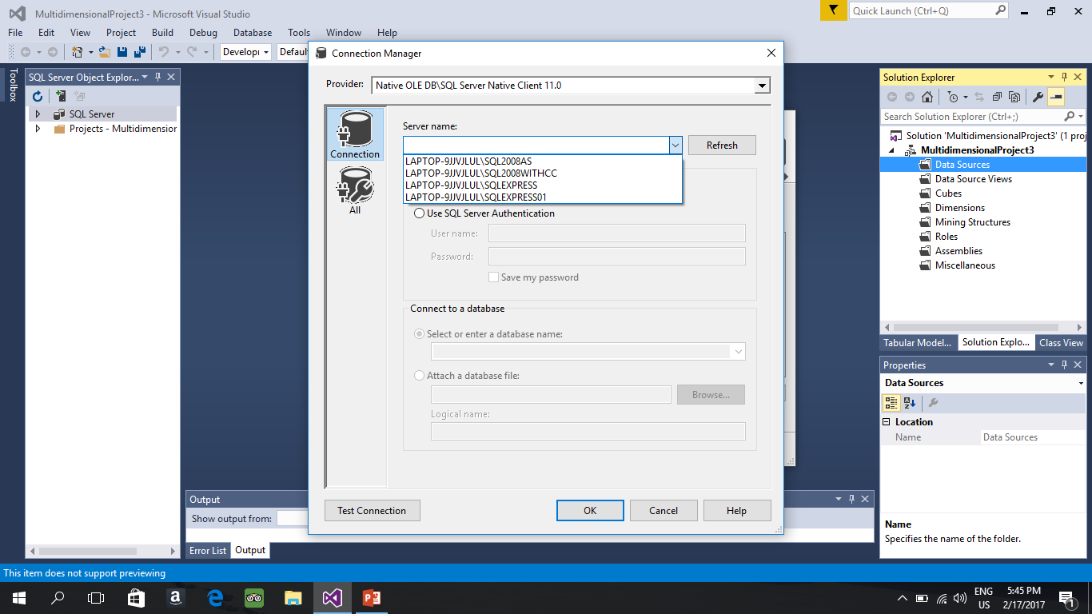
Cont : Choose you Database server instance Don’t use the Analysis service instance

Slide 8
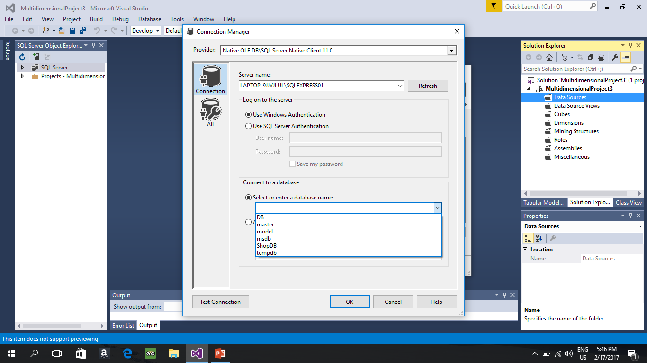
After choosing the server choose the database that you created click ok then Next

Slide 9
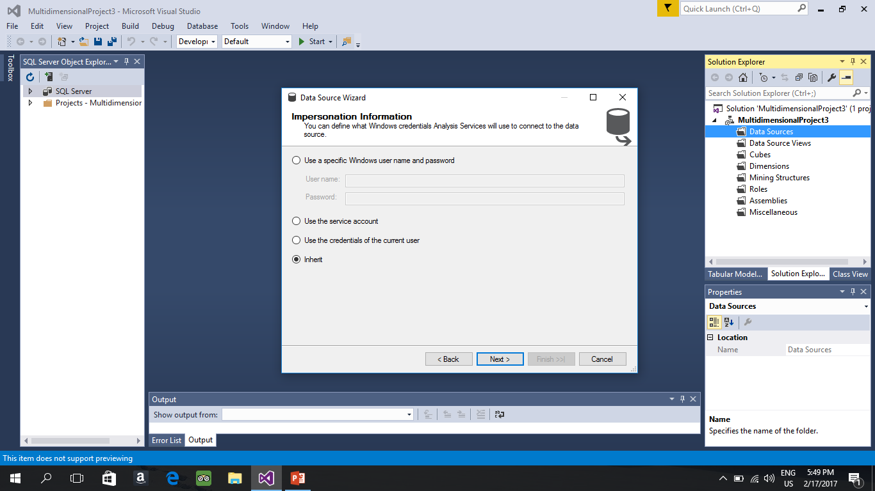
click on inherit

Slide 10
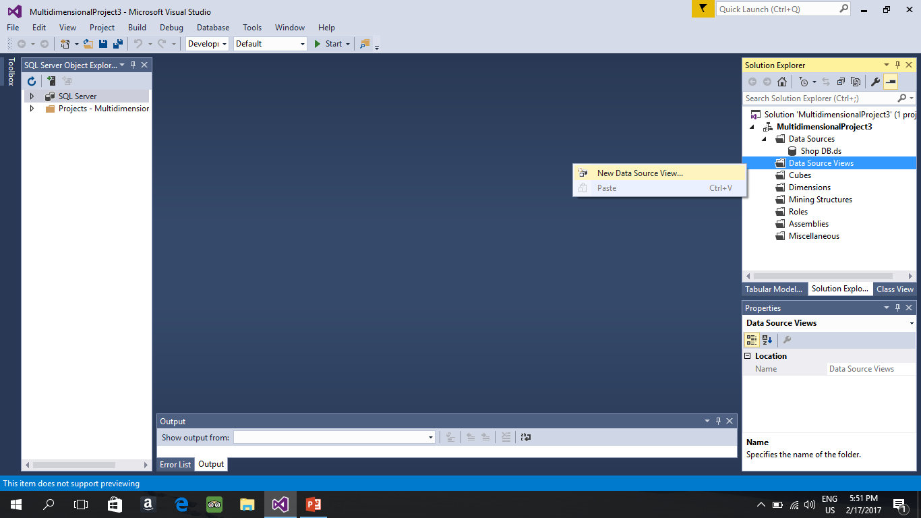
Data Source View

Slide 11
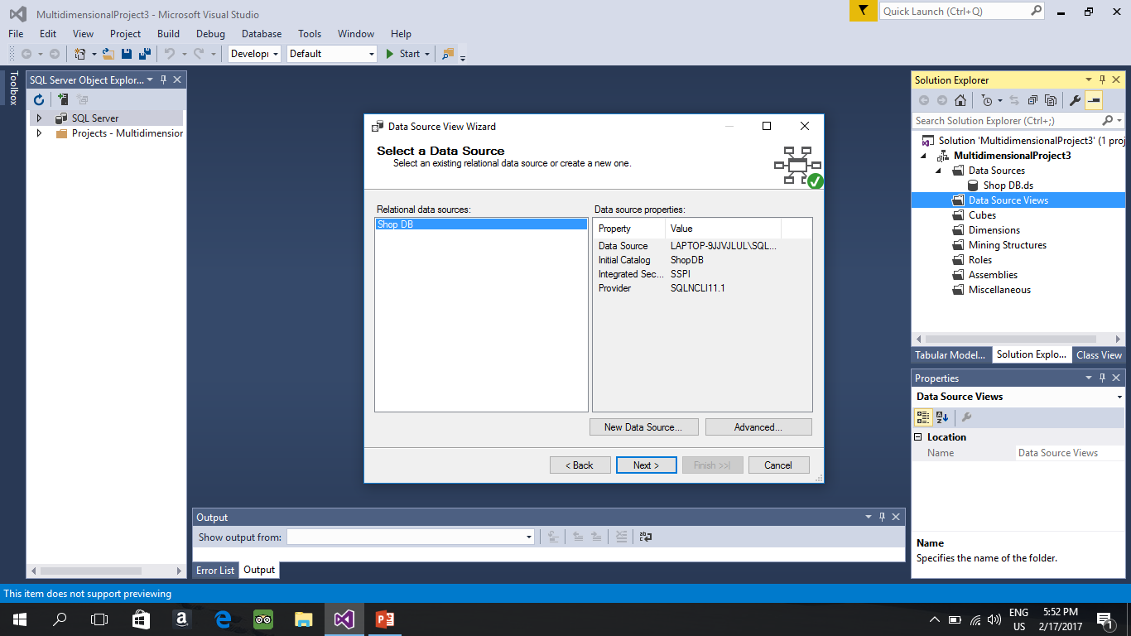
Cont.

Slide 12
Cont.
It will ask you to select the Tables and View, just Bring them all to the right

Slide 13
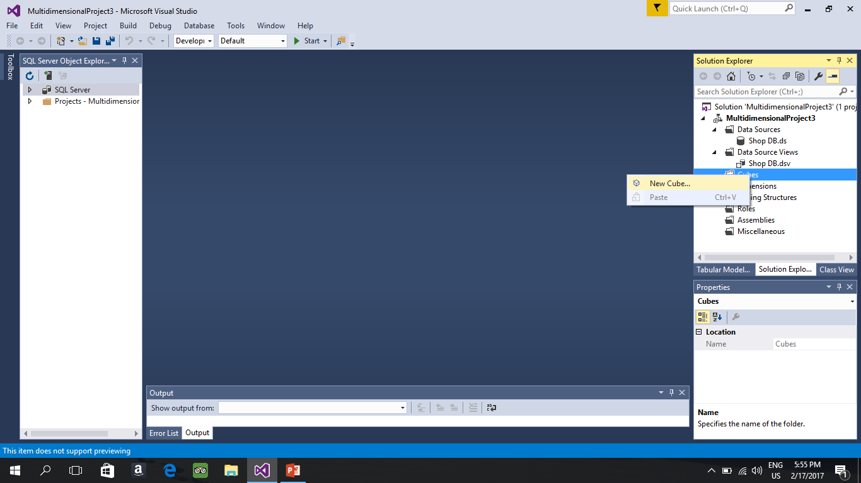
Cube Creation

Slide 14
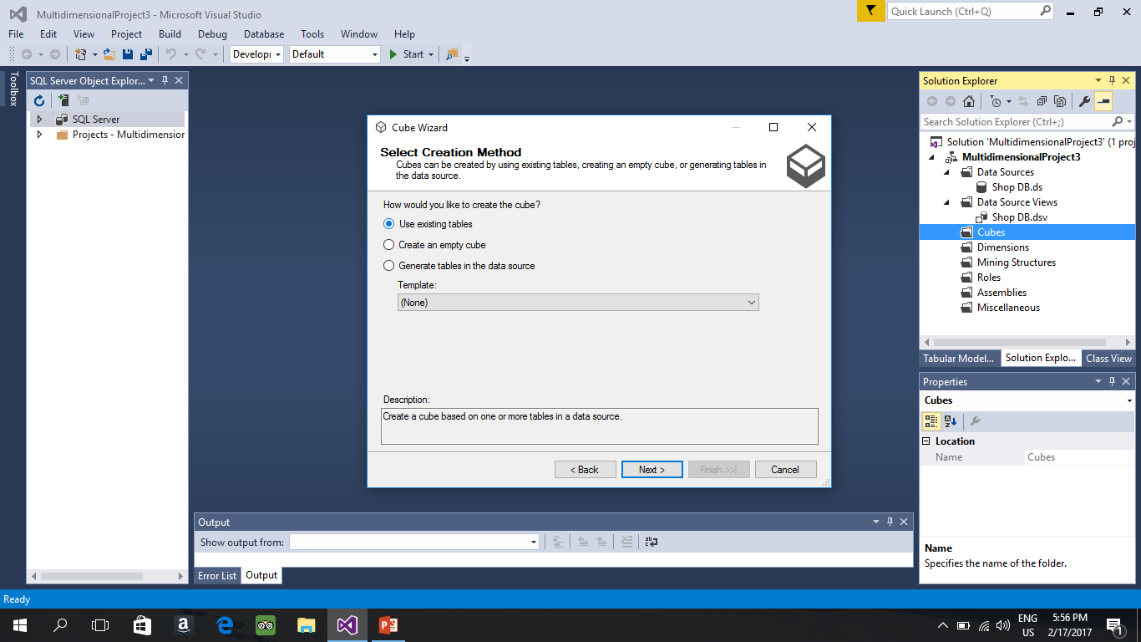
Cont.

Slide 15
Cont.
It will ask you to select measure group table Just Select your Fact Table.
Just proceed by clicking next.
Now your cube is ready you need 3 things :
Creating a hierarchy
Making your cube a “Report Friendly” when browsing your cube.
Giving name to a specific column.

Slide 16
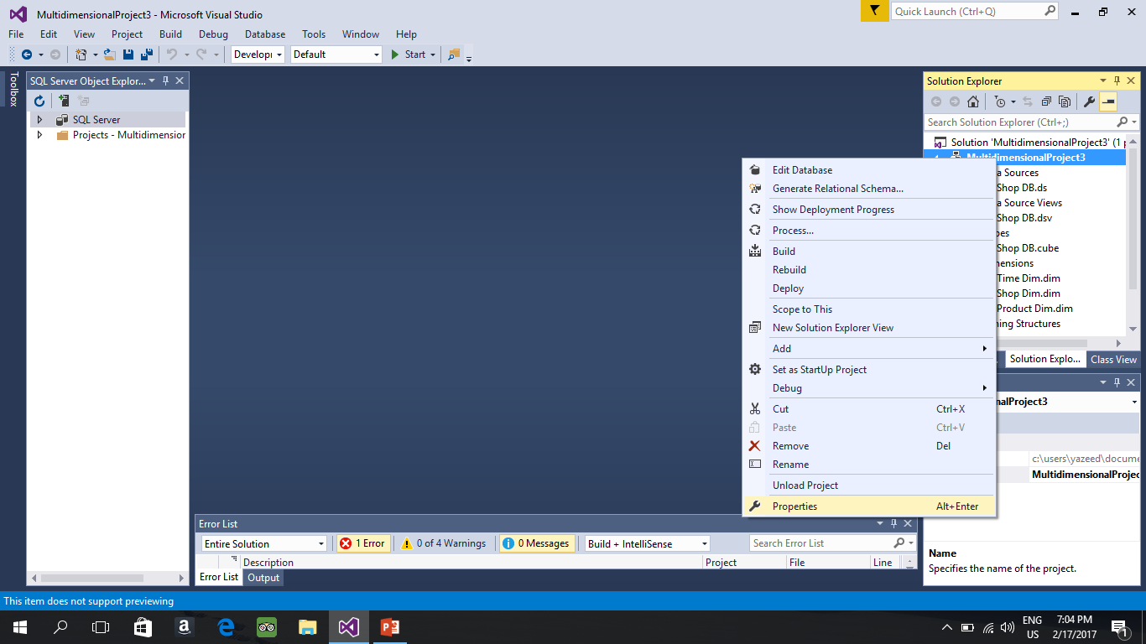
Now we need to Give the Data tools a place where it can store the Cube that we will create

Slide 17
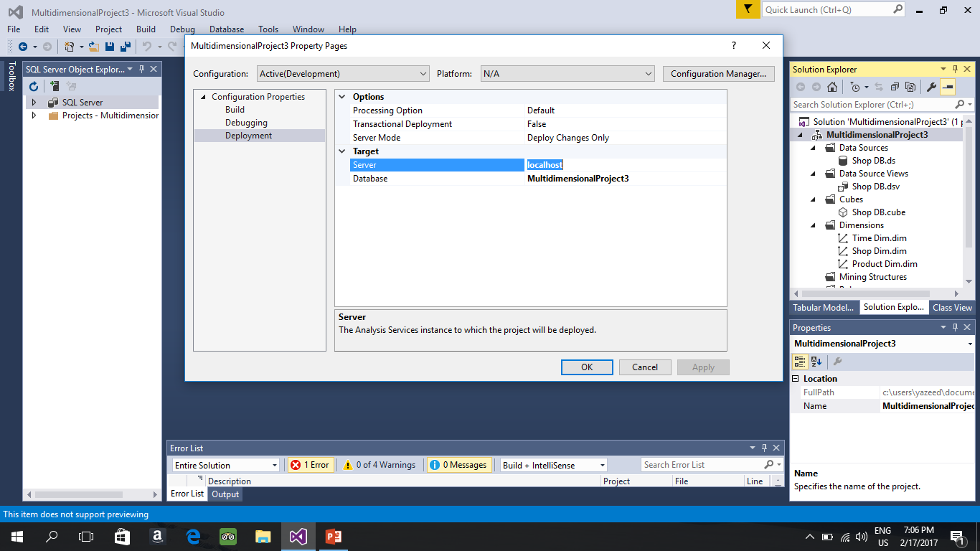
For Analysis Server that you created put it here in the form localhost\(your instance Name that you created) then click ok

Slide 18
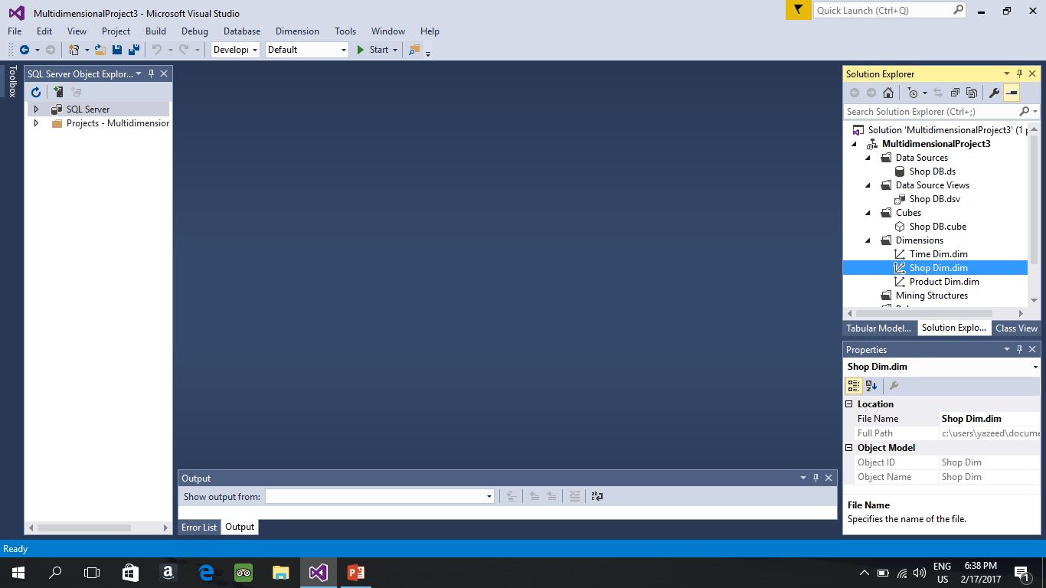
Creating a Hierarchy
Since our Shop Dimension have a hierarchy (mentioned in the Project)
We want to create a hierarchy called Location . Double click on the dimension you want to add a hierarchy on .(Shop)

Slide 19
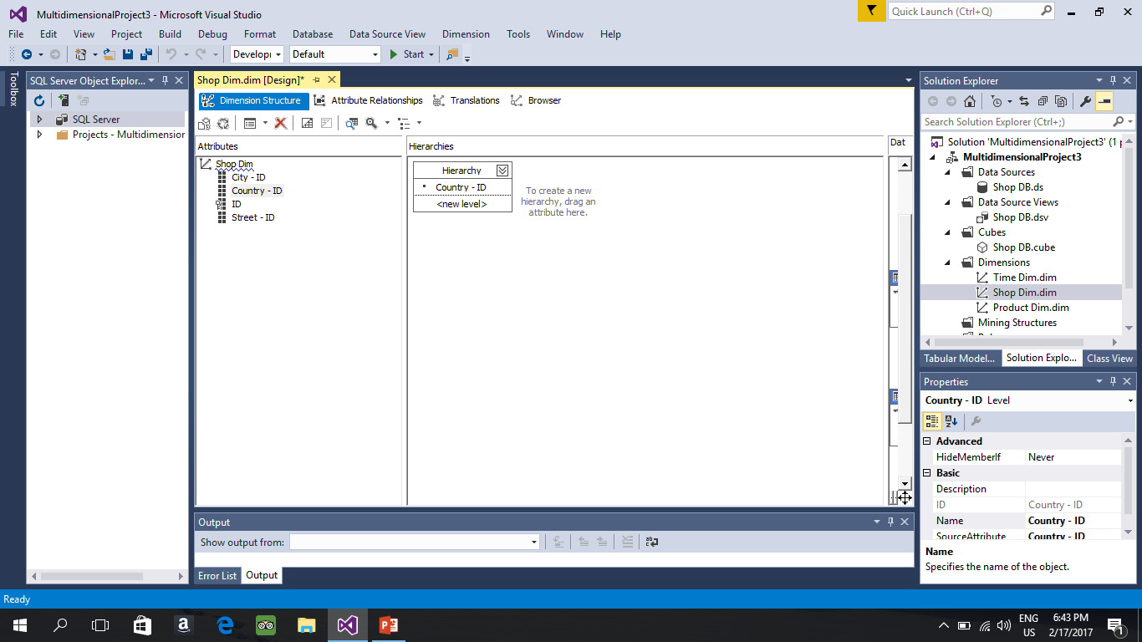
Cont. Drag the highest dim in our case its country and drop it into Hierarchies Box

Slide 20
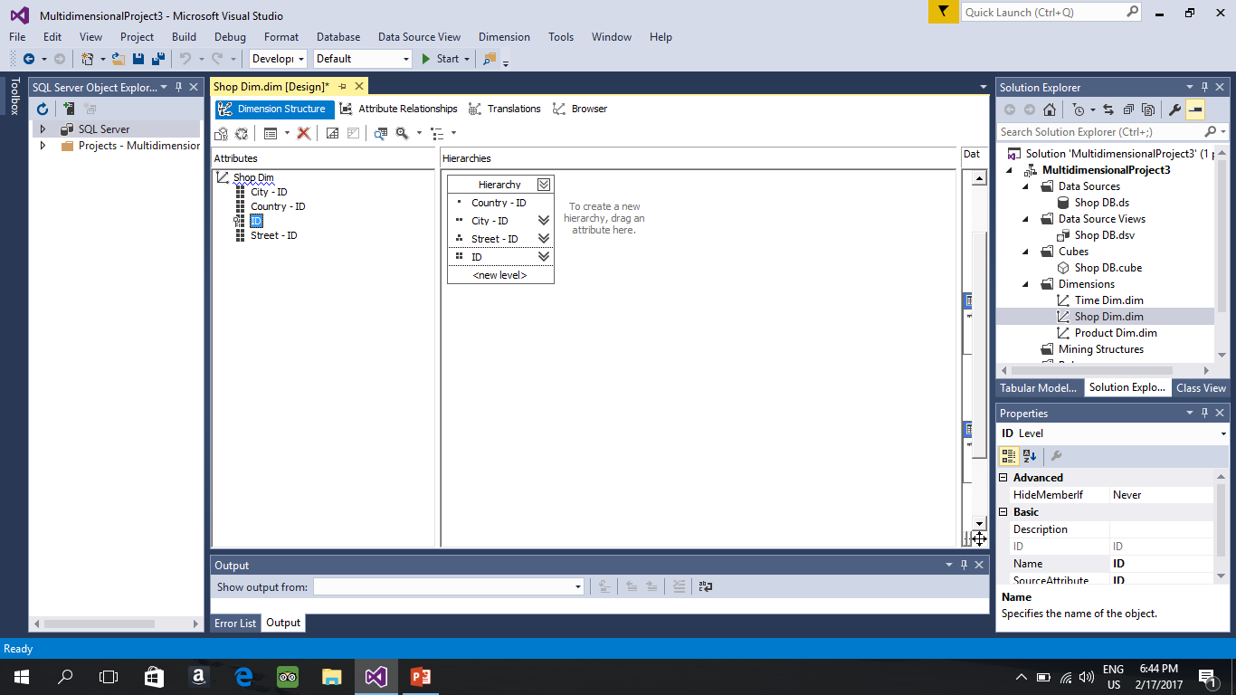
Cont. by dragging the rest of levels

Slide 21
Making the names Report Friendly
In the previous example we have City-ID , Country-ID , Id and Street-ID
We need to change these things we want to be : City , Country , id
And when we browse the cube we want it to have Names not IDs
Next slides will explain.

Slide 22
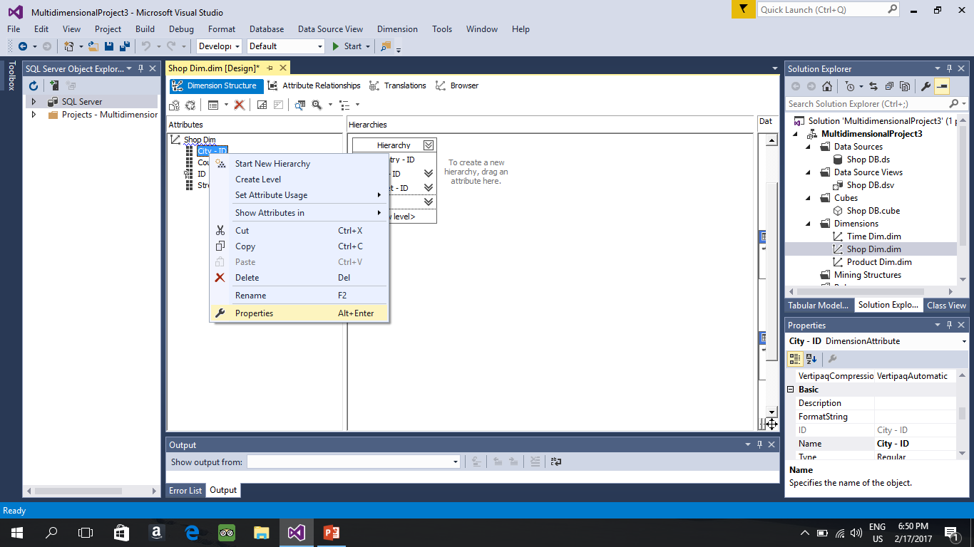
Changing the Name

Slide 23
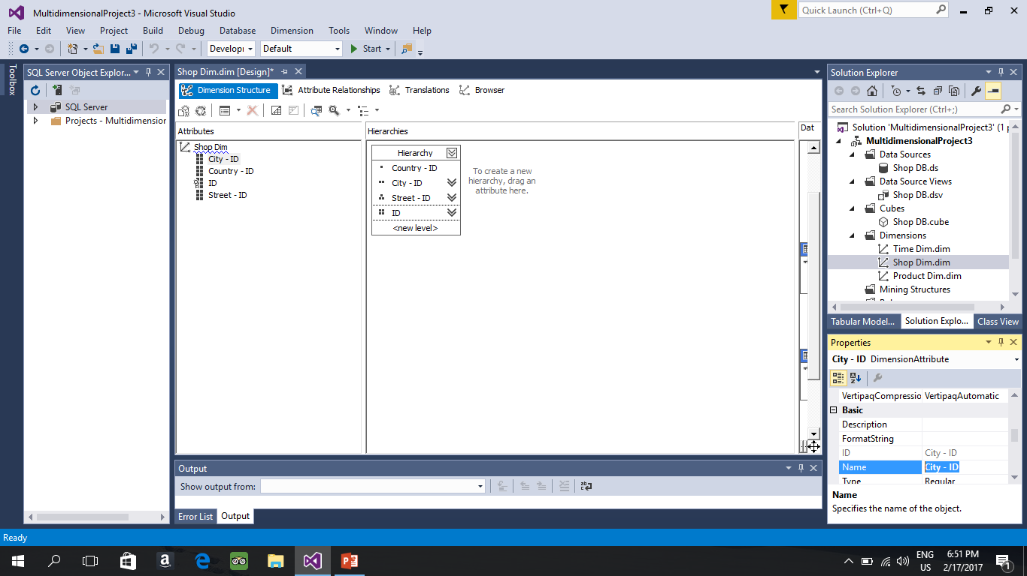
Cont.

Slide 24
The Values that will show in the browse
The values will show when we will process the queue it will show only the ID for example
City Product Quantity
1 2 440
------------------
Next slide will tell how to specify what to appear.

Slide 25
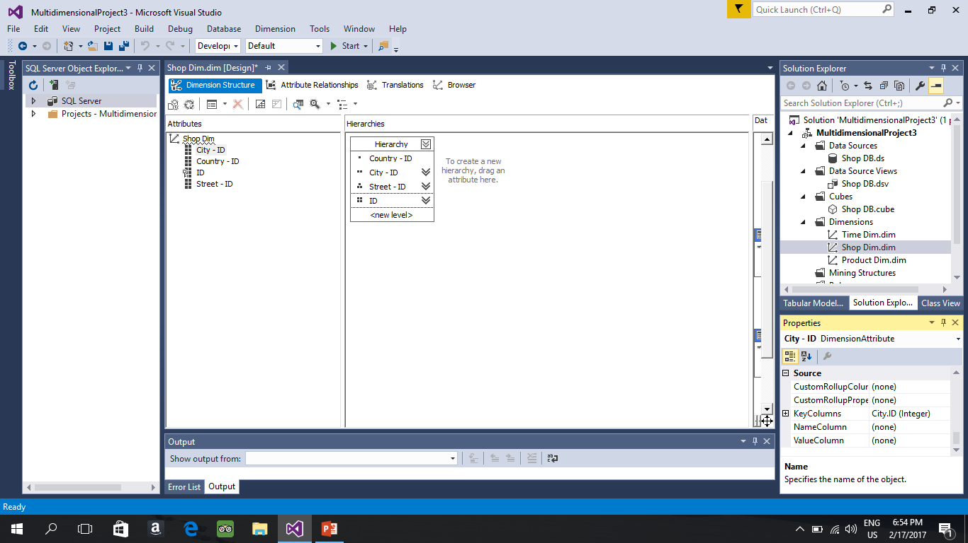
By Default this what you will have

Slide 26
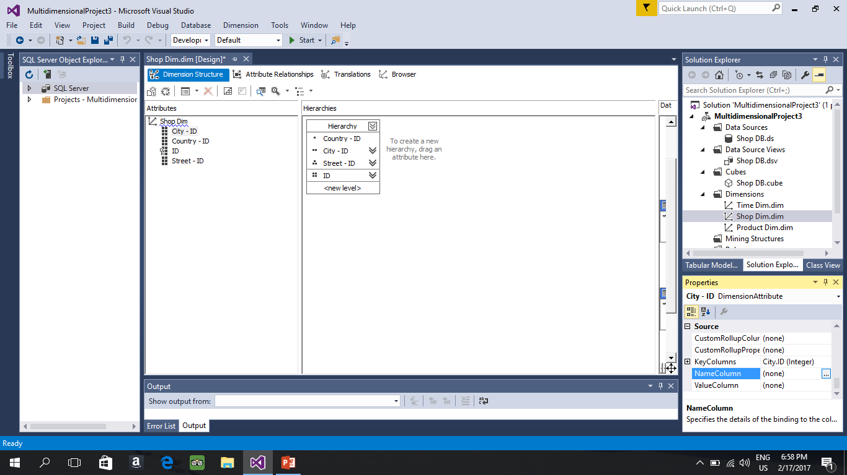
To solve
Change the Namecolumn and ValueColumn to the Attribute that indicate the name in our example

Slide 27
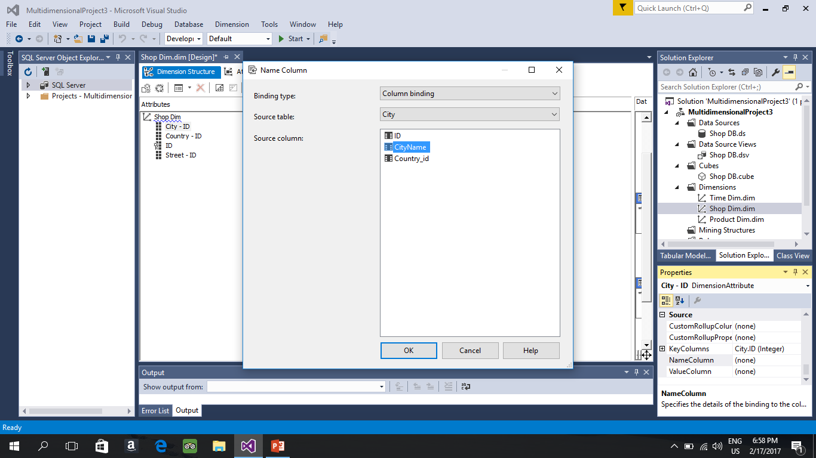
Cont.

Slide 28
Do the same to value column.

Slide 29
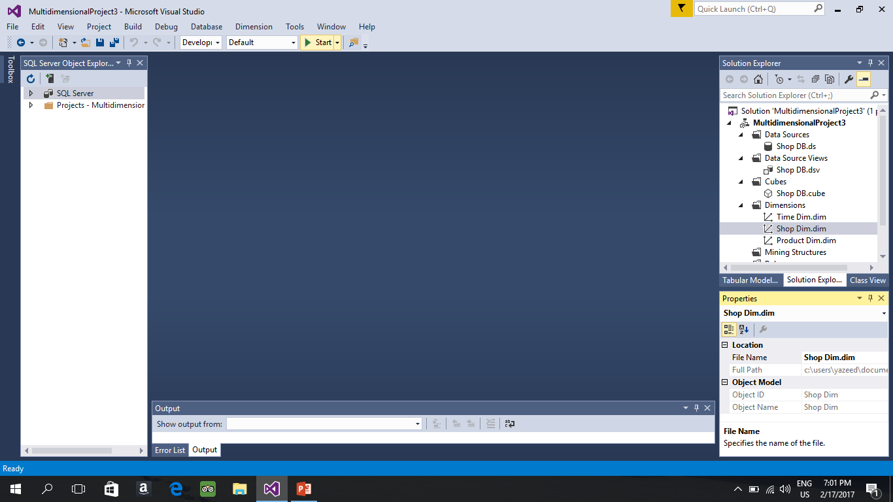
Now we need to Build and Deploy the project and cube so we can browse the cube
Click on Start

Slide 30
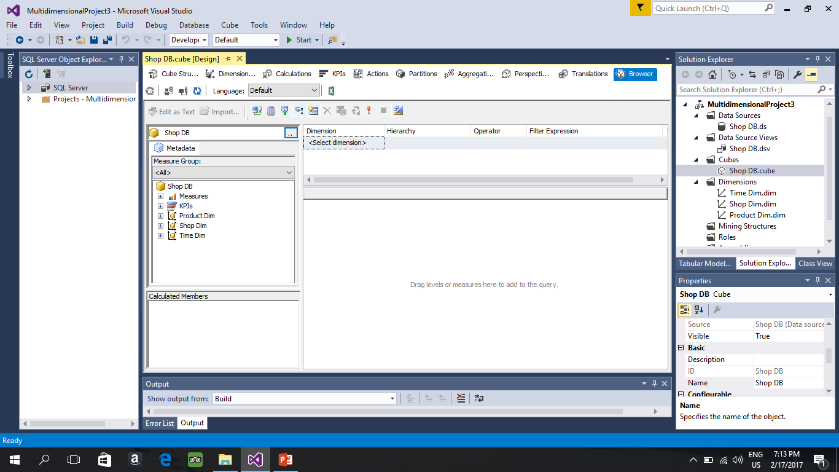
From here you can browse your cube by double click on your cube. Drag and drop dimensions and measure table in the empty space, the [+] Sign you can decide what to add in order to perform roll up and drill down operations

Slide 31
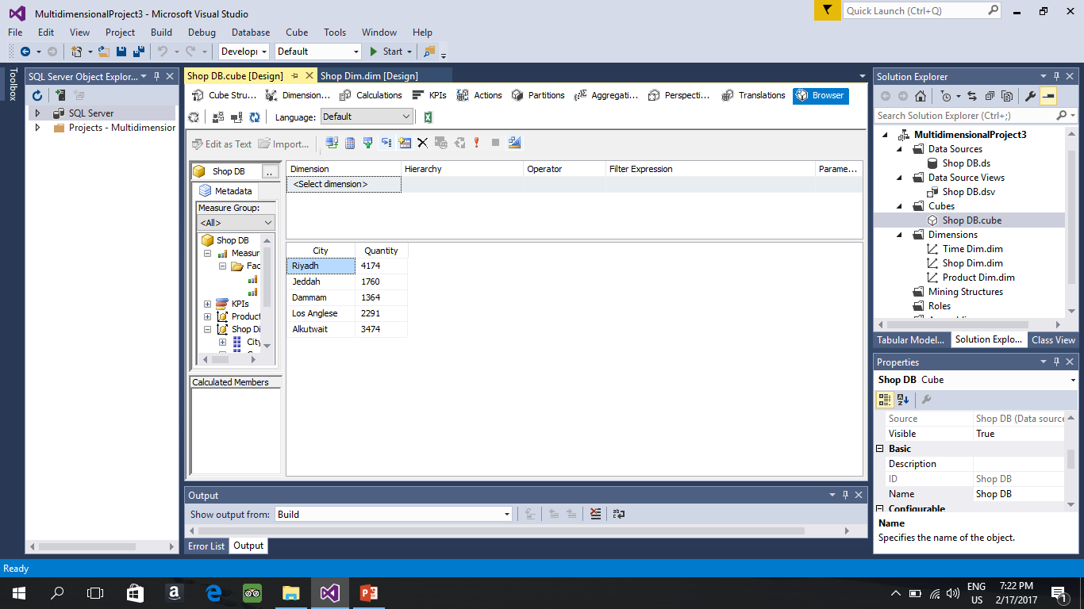
For slice operation you do the following we want only riyadh

Slide 32
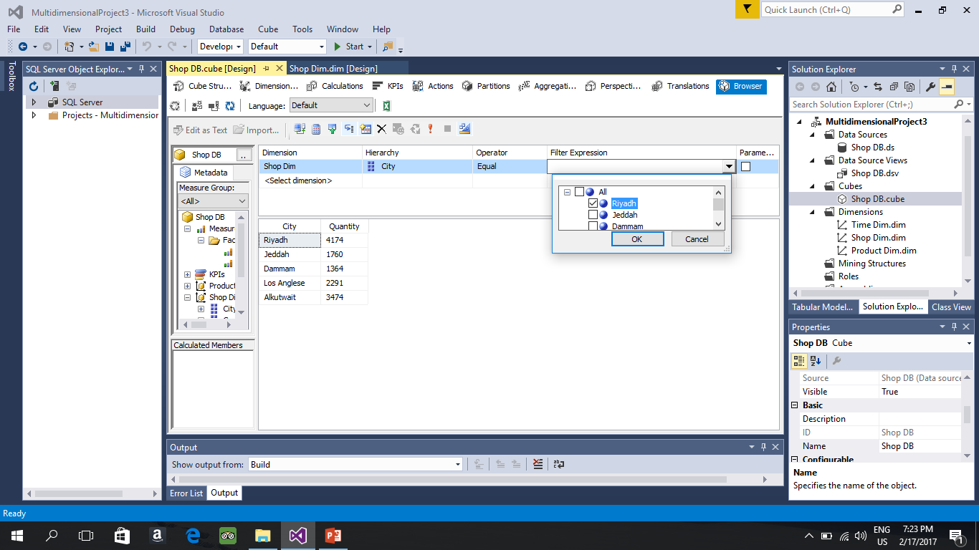

Slide 33


